Slide 1
Targeted delivery of biologics
DevaCell, Inc.

Slide 2
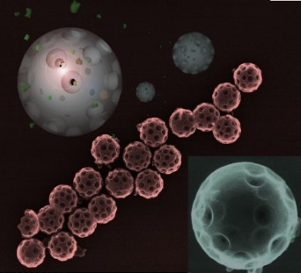
Nanotechnology based injectable therapeutics against cancer
NanoLetters
June 2014
Cover Page:
DevaCell’s SHELS
Technology
Grand Prize: Collegiate Inventors Competition, 2012, Washington DC.
Grand Prize: UC San Diego Entrepreneur Challenge, 2013.
Grand Prize: Medical Research, 2014, Innovation Awards by San Diego Business Journal.

Slide 3
KEY DEAL TERMS

Slide 4
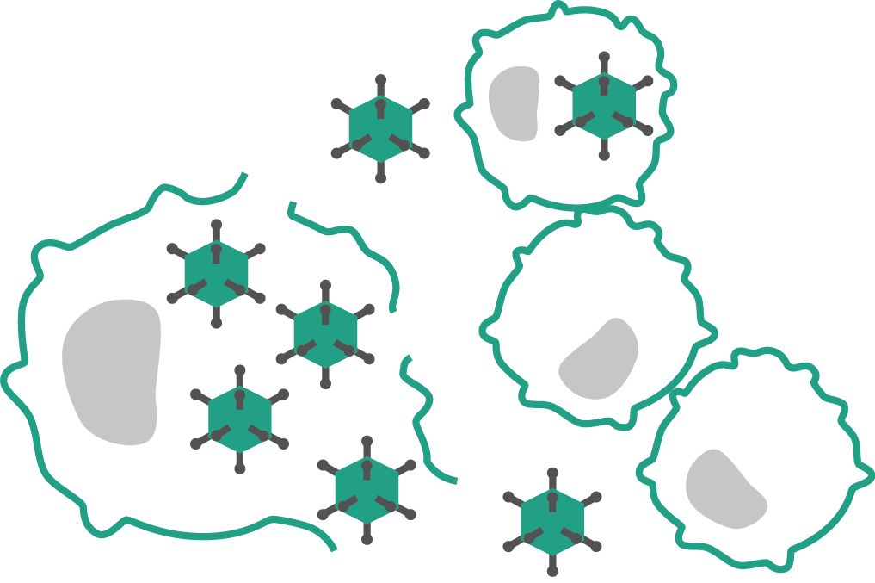
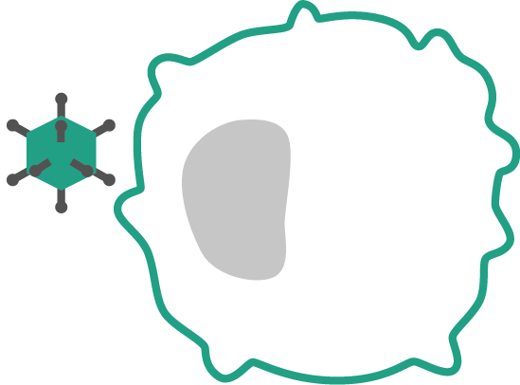
TECHNOLOGY & APPROACH
Oncolytic viruses selectively kill cancer cells
Viruses kill cancer cells using 4 mechanisms:
Directly infect & kill cancer cells
Block tumor blood supply
Suicide gene delivery
Elicit immune response against tumor

Slide 5
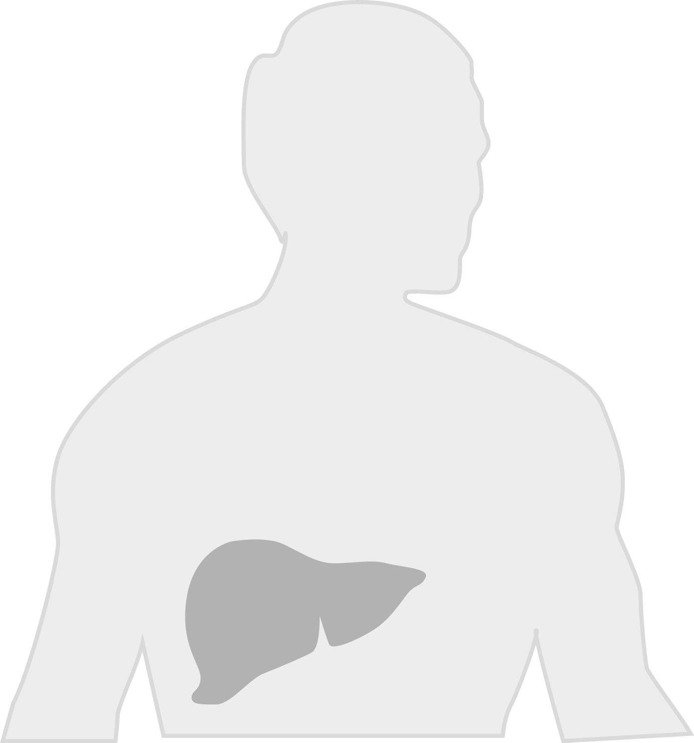
TECHNOLOGY & APPROACH
Gene therapy induces the body’s immune response to the cancer
Therapeutic transgene is delivered by virus
Viruses modified to encode immunostimulatory genes
Transgenes for cytokines, colony-stimulating factors, and tumor-associated antigens
Other gene therapy methods:
Introducing wild-type p53 gene
Gene directed pro-drug therapy
Incites immune response against tumor
Proprietary & confidential

Slide 6
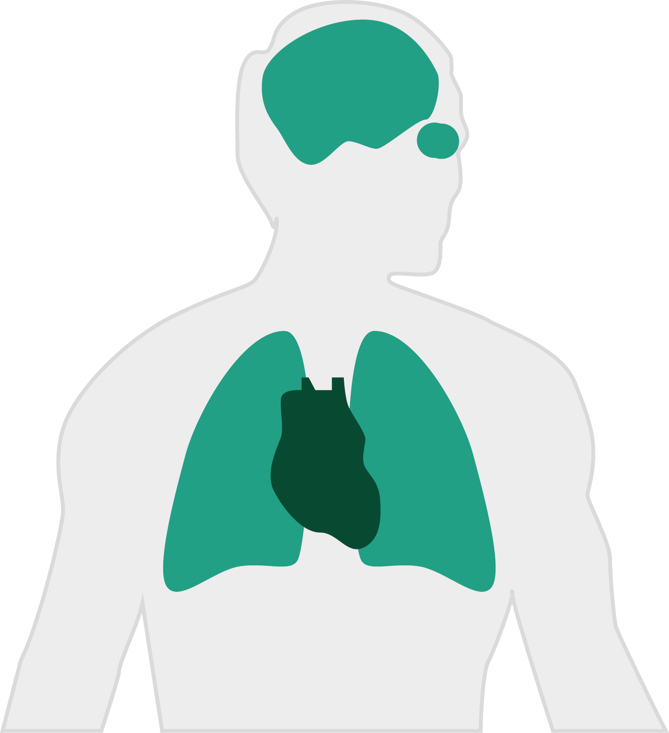
TECHNOLOGY & APPROACH
Gene virotherapy also trialed for most major diseases
Ocular (2%)
7+ conditions
e.g. Glaucoma
Neurological (2%)
Alzheimer’s
ALS
Epilepsy
MS
Myasthenia gravis
Parkinson’s
Pain
Cancer (64%)
Gynaecological
Nervous system
Gastrointestinal
Genitourinary
Skin
Head & neck
Lung
Sarcoma
Thyroid
Monogenic (9%)
33+ conditions
e.g. Cystic fibrosis
Cardiovascular (8%)
10+ conditions
e.g. Coronary artery disease
Other (15%)
25+ conditions
e.g. Arthritis, HIV, Malaria, Tetanus, Tuberculosis
Proprietary & confidential

Slide 7
PROBLEM
Virotherapy has serious limitations
Virus rapidly eliminated by
Virus infects some tissues poorly
Immune response
Liver filtration
Hampers multiple cycles
Adaptive immune system remembers virus
Typical circulation half-life of virus ~2min
Limited cancer targets
Tumor microenvironments & heterogeneity pose problems
Proprietary & confidential

Slide 8
OnCoat™ platform
Virotherapy enabler
Bare virus rapidly neutralized by antibodies
OnCoat™ stealth coating
OnCoat™ Targeting Kit
Shields from immune response
Coating based on silica
Versatile coating can be modified with highest density of functionalization molecules
Serve repeat therapy with no loss of efficacy
Give virus tropism to new cancer targets
Use lower, safer dose
Keep virus away from liver
Proprietary & confidential

Slide 9
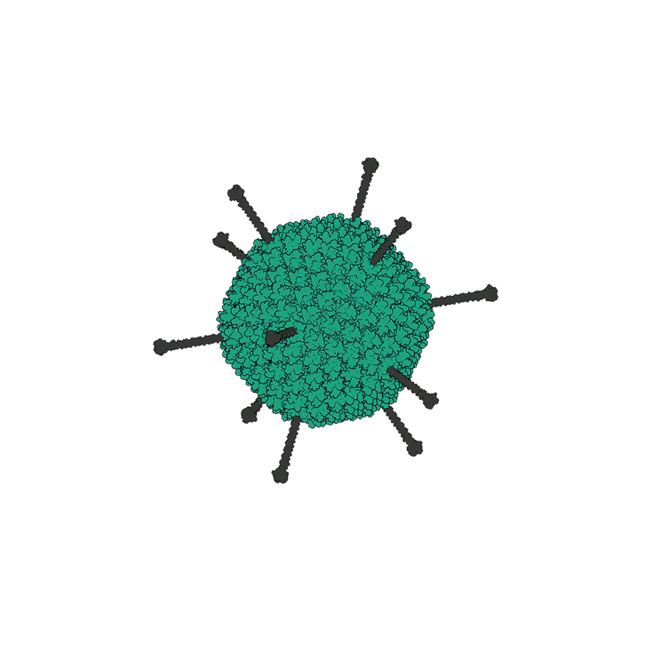
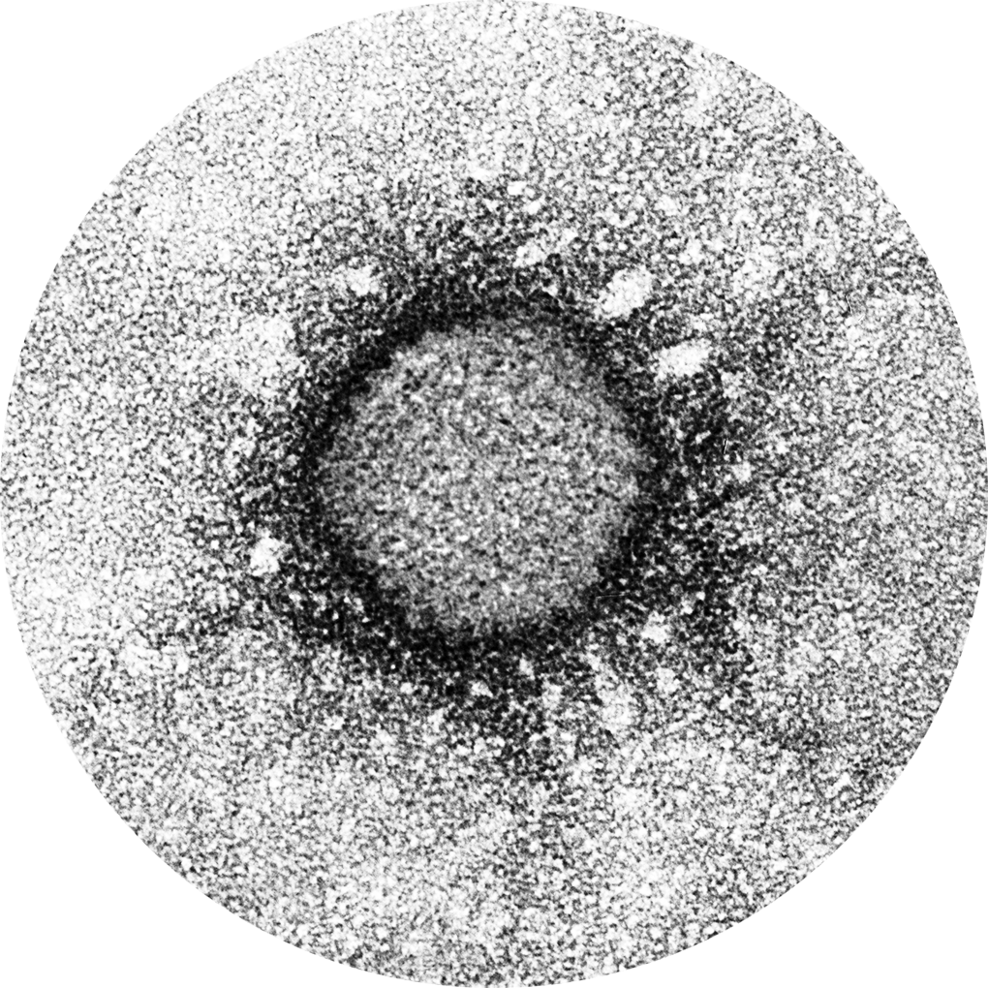
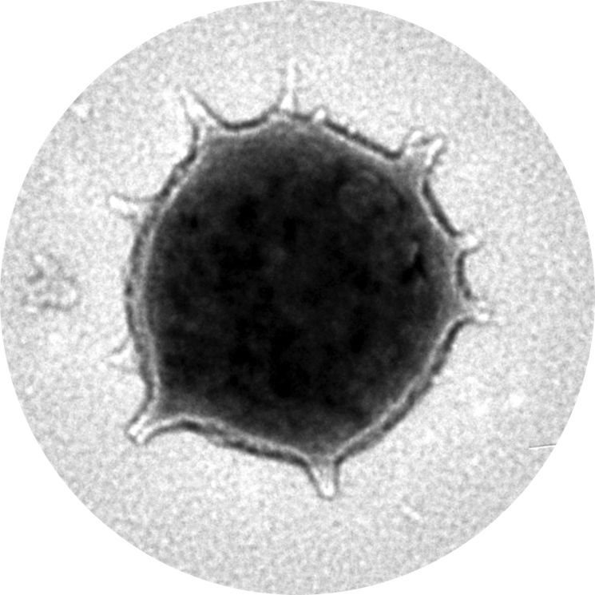
OnCoat™ Technology
OnCoat™ imaged using an electron microscope
Bare Adenovirus
OnCoat™-AdV
100nm
Proprietary & confidential

Slide 10
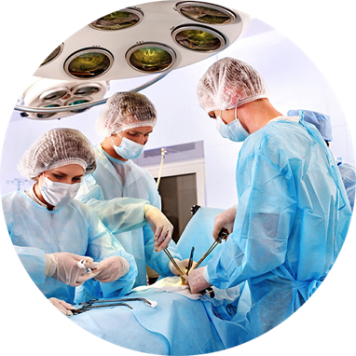
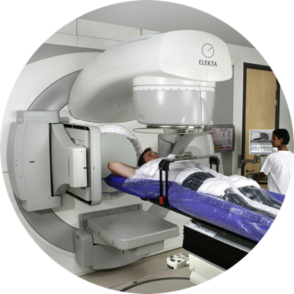
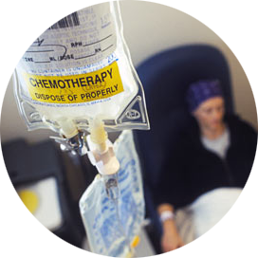
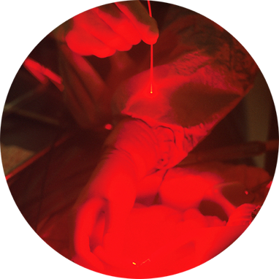
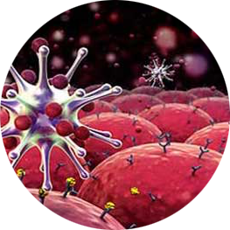
OnCoat™ Technology
Virotherapy has strong combination therapy potential
Surgery
Radiotherapy
Chemotherapy
Phototherapy
Photodynamic
Photothermal
Biological therapy
Gene therapy / virotherapy
Monoclonal antibodies
Growth blocking factors
Proprietary & confidential

Slide 11
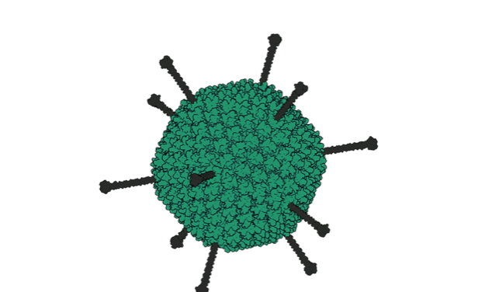
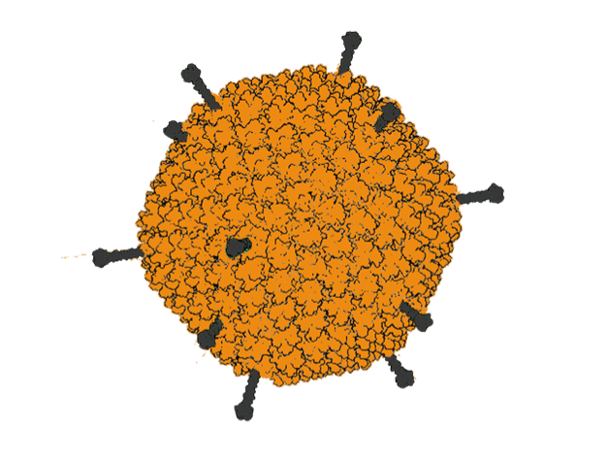
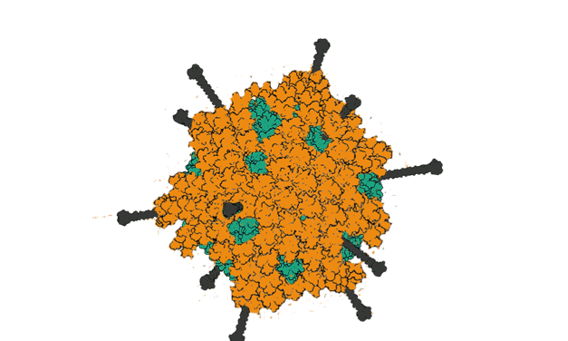
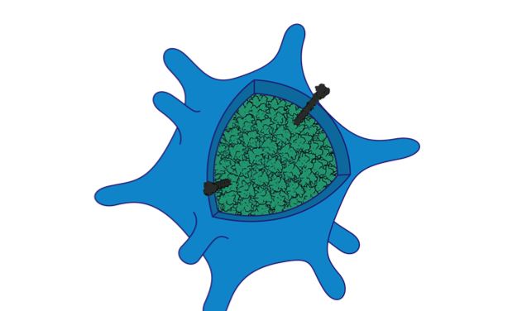
OnCoat™ Technology
Highest efficacy and most versatile virus delivery
Bare virus
Polymer bonding to virus
OnCoat™ stealth shield
Delivery strategies:
Use strong dose
Use immunosuppressant drugs
Use rare serotypes
Chemically bind HPMA copolymer to virus surface for immune shielding
Bind PEG polyether to de-target virus
Unique silica coating to shield virus from immune system and delivery it to cancer cells
Virus not chemically altered, retaining full infectivity on release
Simple bulk-manufacturing at room temperature
Highest density of targeting ligands can be attached
Limitations:
Has not been tested on enveloped viruses
Limitations:
Rapid clearance makes intravenous unfeasible
High dose increases side effects
Immunosuppressants inhibit vital immunotherapy mechanism
Rapid adaptation to serotype
Only applicable to Adenovirus & AAV
Chemistry reduces infectivity
Limited surface versatility
No clinical trials
Proprietary & confidential

Slide 12
Intellectual Property
Exclusive technology licensed from University of California & Moores Cancer Center
Licensing Terms:
Exclusive, world-wide, 2.5% royalty with no equity, no veto rights
General therapy (not just cancer) + diagnostics rights
Sub-licensing, combination product , M&A rights without restrictions
Proprietary & confidential

Slide 13
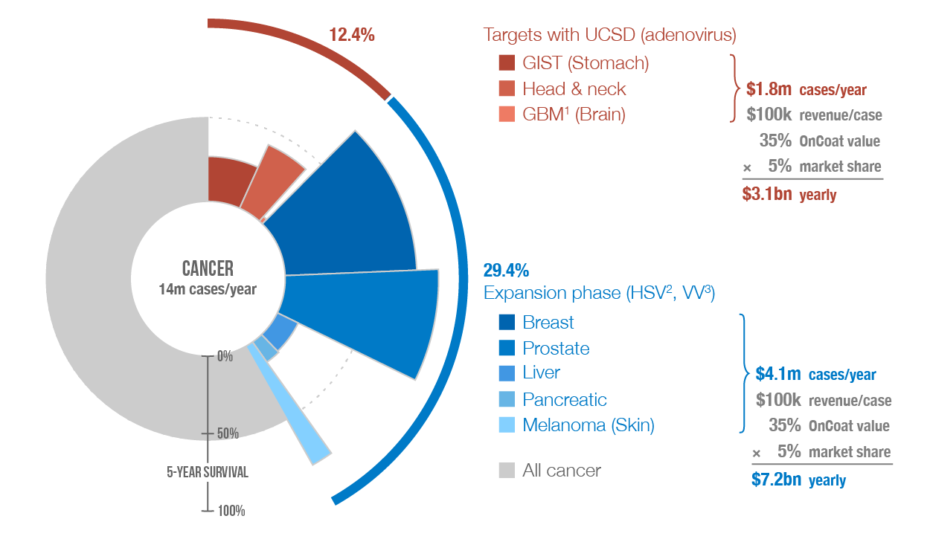
Commercial Applications
OnCoat™ initial applicable market is 40% of cancers
Notes: ¹ Glioblastoma multiforme; ² Herpes Simplex virus (HSV); ³ Vaccinia virus (VV)
Sources: GLOBOCAN 2012 (incidents); American Cancer Society (survival)
Proprietary & confidential

Slide 14
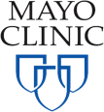
Commercial Applications
Establish deep partnerships on product-specific basis
Form joint ventures to develop, manufacture & commercialize for global market
DevaCell enables pharma…
Pharma
new markets for existing therapy
increased revenue-per-head due to repeat treatments
clinical trials “insurance policy” as an alternative delivery method
increased exit value to Pharma for virotech
significant de-risking of trials due to lower dose + retargeting
SPV (special purpose vehicle) joint-venture with independent funding & compartmentalised risk
Phase II/III
Pre-cl./Phase I
Proprietary & confidential

Slide 15
Commercial Applications
Many on-going clinical trials: potential partners, customers..
Sponsor
Virus¹
Ph. I
II
III
Entry²
Gene therapy
Targets
Advantagene (MA)
Adenovirus
IV/IT
-
Prostate, glioma, pancreas, colon
Cold Genesys (CA)
Adenovirus
VE
GM-CSF (immune system)
Bladder
DNAtrix (TX)
Adenovirus
IV/IT
-
Glioblastoma
PNP Therapeutics (AL)
Adenovirus
IT
E. coli PNP (prodrug therapy)
Head, neck
Ziopharm (MA)
Adenovirus
IT
hIL-12 (immune system)
Melanoma, glioblastoma
Shangai Sunway Bio.
Adenovirus
IT
-
Head & neck, esophagus
SiBiono GeneTech Co.
Adenovirus
IV/IT
p53 (cell cycle regulation)
Head & neck, lung, GIST
Momotaro-Gene
Adenovirus
IT
REIC (tumor suppressor)
Prostate
Oncos Therapeutics
Adenovirus
IV/IT
GM-CSF
Sarcoma, lung, ovarian
PsiOxus Therapeutics
Adenovirus
IV/IT
-
Colon, lung, bladder, renal cell
VCN Biosciences
Adenovirus
IV/IT
PH20 (tumor structure)
Pancreas, solid tumors
Genelux Corp. (CA)
Vaccinia
IV
H-IL-6
Head & neck, lung, solid tumors
SillaJen (Jennerex) (CA)
Vaccinia
IV
n.a.
Liver, kidney, solid tumors
AMGEN (BioVex)
HSV
IT
GM-CSF
Melanoma
OrienGene Bio.
HSV
IT
n.a.
Melanoma, liver, pancreas, lung
Virttu Biologics
HSV
IT
VDEPT/NAT/ING4
Lung, sarcoma, liver, brain, nerve
Viralytics
Coxsackie
IV/IT
n.a.
Head & neck, lung, solid tumors
Oryx GmbH & Co.
Parvovirus
IV/IT
n.a.
Glioblastoma
Oncolytics Bio.
Reovirus
IV/IT
n.a.
Many various cancers (33 trials)
Neotropix (PA)
Seneca Valley
IV
n.a.
Lung, brain
Mayo Clinic (MN)
VSV/Measles
IT
n.a.
Many various cancers
Note: ¹ Herpes Simplex virus (HSV), Vesicular stomatitis virus (VSV); ² Intravenous (IV), Intratumoral (IT), Intravesical (VE), Subcutaneous (SC)
15

Slide 16
Exit Analysis
Recent gene-/onco-tech exits
Major players investing in
platform technology
Selected start-up financing
since 2013
BioVex to
Cancer
$1bn
Juno Therapeutics
Cancer
$120m
Merrimack to
Cancer
(1× non-US drug license)
$970m
Celladon
Advanced heart failure
$51m
GenSight Biologics
Genetic blindness
$41m
Jennerex to
Cancer
$150m
Viralytics
Cancer
$27m
Exit
Drug license
DNAtrix
Cancer
$20m
Cold Genesys
Cancer
$14m
Series A
Series B or other

Slide 17
DevaCell Exit
Near term sublicensing revenue – multiple exits windows
Year 1
Year 2
Year 3
Year 4-6
lead compounds & biologics | Pre-Clincal Work | Non-clinical work | IND Application US FDA | EU EMA Treating 40 patients @ cost of 120,000 PLN per patient
Value Inflection Points
Year 2 Revenue
Sub licensing for other virus (i.e. herpes) for upfront cash & future royalties
Year 3
Exit Scenario 1:
@ start of human clinical trials – IND
Diluted equity @ 3 years: 100% Exit proceeds: ~$100M – 3 year ROI = 20X
Year 5
Exit Scenario 2:
@ end of human Phase I clinical trials
Diluted equity @ 5 years: 80% Exit proceeds: ~$250M – 4 year ROI = 40X
Year 8
Exit Scenario 3:
@ end of human Phase iI clinical trials
Diluted equity @ 5 years: 64% Exit proceeds: ~$1BM – 8 year ROI = 128X

Slide 18
Financing
DevaCell plan calls for 5M PLN tranched in over 3 years
 | PRE-CLINICAL |  |  | CLINICAL
Sources | Year 1 | Year 2 | Year 3 | Year 4 | Year 5 | Year 6
Devacell American Investor | PLN 1,100,000 | PLN 1,100,000 | PLN 1,100,000 | PLN 0 | PLN 0 | PLN 0
Polish Series A Investor | PLN 1,100,000 | PLN 1,100,000 | PLN 1,100,000 | PLN 0 | PLN 0 | PLN 0
Global Series B Investor |  |  |  | PLN 2,700,000 | PLN 2,700,000 | PLN 2,700,000
Total Private Capital | PLN 2,200,000 | PLN 2,200,000 | PLN 2,200,000 | PLN 2,700,000 | PLN 2,700,000 | PLN 2,700,000
NCBiR | PLN 6,600,000 | PLN 6,600,000 | PLN 6,600,000 | PLN 8,100,000 | PLN 8,100,000 | PLN 8,100,000
Total | PLN 8,800,000 | PLN 8,800,000 | PLN 8,800,000 | PLN 10,800,000 | PLN 10,800,000 | PLN 10,800,000
Uses | Year 1 | Year 2 | Year 3 | Year 4 | Year 5 | Year 6
Executive | PLN 1,897,500 | PLN 2,330,000 | PLN 2,330,000 | PLN 2,330,000 | PLN 2,330,000 | PLN 2,330,000
R&D PRECLINICAL | PLN 2,286,000 | PLN 3,180,000 | PLN 3,180,000 | PLN 5,821,667 | PLN 5,696,667 | PLN 5,696,667
R&D CLINICAL |  |  |  | PLN 3,266,667 | PLN 3,266,667 | PLN 3,266,667
Operational Expenses | PLN 391,766 | PLN 409,410 | PLN 451,554 | PLN 451,698 | PLN 451,842 | PLN 451,986
NCBiR Grant Application Fees | PLN 0 | PLN 330,000 | PLN 330,000 | PLN 405,000 | PLN 405,000 | PLN 405,000
Capex Purchases | PLN 149,500 | PLN 0 | PLN 0 | PLN 0 | PLN 0 | PLN 0
Working Capital | PLN 4,075,234 | PLN 2,550,590 | PLN 2,508,446 | -PLN 1,475,031 | -PLN 1,350,175 | -PLN 1,350,319
Total | PLN 8,800,000 | PLN 8,800,000 | PLN 8,800,000 | PLN 10,800,000 | PLN 10,800,000 | PLN 10,800,000
Cash Reserves/Cash Low Point | PLN 3,745,234 | PLN 2,550,590 | PLN 2,508,446 | PLN 4,300,081 | PLN 6,216,573 | PLN 8,132,920
Monthly Cash Burn | PLN 382,651 | PLN 496,797 | PLN 496,797 | PLN 706,531 | PLN 706,543 | PLN 706,555
Runway (in months) | 9.8x | 5.1x | 5.0x | 6.1x | 8.8x | 11.5x
headcount | 17 | 18 | 19 | 19 | 19 | 19

Slide 19
DevaCell Team
International, Nobel Prize Laureate
Management
Chief Executive Officer: Ibrahim Yayla, PhD in microelectronics and applied physics
Chief Technology Officer: Inanc Ortac, PhD in chemistry and nanofabricatio
Chairman of Advisory Board: Sadik C. Esener, PhD – Professor of Nanotechnology
Co-founders’ track record: 8 companies funded collectively, 300M$ aggregate exit volume
Scientific Advisory Board
Roger Tsien PhD – 2008 Nobel Prize laureate in Chemistry
Dennis Carson MD PhD – Oncologist & Former director of Moores Cancer Center
William Trogler PhD – Co-inventor of core technology. Professor of Chemistry, UCSD
Collaborators
Dennis Carson, MD PhD – Oncology
Tony Reid, MD PhD – Oncolytic Virotherapy
Thomas Kipps, MD PhD – Leukemia
Murat Digicaylioglu, MD PhD, Neurosurgeon – Brain tumors

Slide 20
Abe Layla, Ph.D. 001 858 669-4775 iyayla@devacell.com
DevaCell, Inc.
Contact
Geoffrey Folkerth, MBA 001 858 335-7988 geoffrey.folkerth@mac.com

